Slide 1
Natural Language Processing and N-GRAMS
Submitted by SEMINAR COORDINATOR
Rahul Dokania Ms. V.Madhavi
16841A0527

Slide 2
What is NLP ?
”Natural language processing (NLP) is a field of computer science, artificial intelligence (also called machine learning), and linguistics concerned with the interactions between computers and human (natural) languages. Specifically, the process of a computer extracting meaningful information from natural language input and/or producing natural language output ”
- Wikipedia

Slide 3
Tasks in NLP
Tokenization / Segmentation
Bag of Words
Stemming
Lemmatization
Part of Speech (POS) tagging

Slide 4
Segmentation
Segmenting text into words
“The meeting has been scheduled for this Saturday.” “He has agreed to co-operate with me.”
“Indian Airlines introduces another flight on the New Delhi–Mumbai route.”
“We are leaving for the U.S.A. on 26th May.”
“Vineet is playing the role of Duke of Athens in A Midsummer Night’s Dream in a theatre in New Delhi.”
Named Entity Recognition

Slide 5
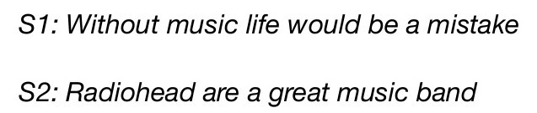
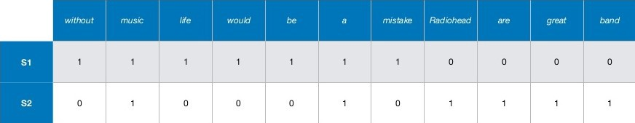
Bag of Words

Slide 6
Stemming
Stemming is the process for reducing end or beggining of words with the intention of removing affixes .
•
•
•
playing
running
->play
-> run
news -> new (error)

Slide 7
Lemmatization
Lemmatization is the process for reducing inflected (or sometimes derived) words to their stem, base or root form.
•
•
•
car, cars
run, ran, running
-> car
-> run
stemmer, stemming, stemmed -> stem

Slide 8
POS tagging
Part of speech (POS) recognition
“ Today is a beautiful day. “
Today Noun
is Verb
a
Article
beautiful Adjective
day Noun
“Interest rates interest economists for the interest of the nation.“
(word sense disambiguation)

Slide 9
General tasks and techniques in NLP
NLP uses machine learning as well as other AI systems in general. More specifically NLP Techniques fall mainly into 3 categories:
Symbolic
Deep analysis of linguistic phenomena human verification of facts and rules
use of inferred data – knowledge generation
Statistical
Mathematical models without much use of linguistic phenomena use of large corpora
Use of only observable knowledge
Connectionist Use of large corpora
allows inferencing from the examples

Slide 10
N-GRAMS
N-grams of texts are extensively used in text mining and natural language processing tasks. They are basically a set of co-occuring words within a given window and when computing the n-grams you typically move one word forward (although you can move X words forward in more advanced scenarios). For example, for the sentence "The cow jumps over the moon". If N=2 (known as bigrams), then the ngrams would be:
the cow
cow jumps
jumps over
over the
the moon

Slide 11
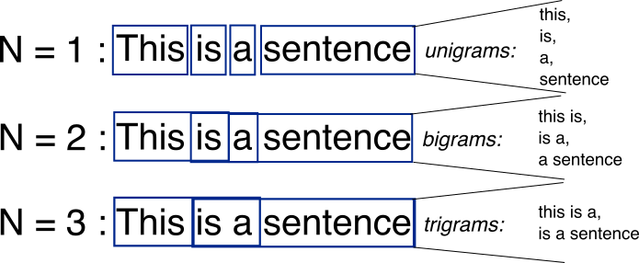

Slide 12
USES OF N-GRAMS
It can also help make next word predictions. Say you have the partial sentence “Please hand over your”. Then it is more likely that the next word is going to be “test” or “assignment” or “paper” than the next word being “school”.
It can also help to make spelling error corrections. For instance, the sentence “drink cofee” could be corrected to “drink coffee” if you knew that the word “coffee” had a high probability of occurrence after the word “drink” and also the overlap of letters between “cofee” and “coffee” is high. As you can see, assigning these probabilities has a huge potential in the NLP domain.

Slide 13
Why NLP ?

Slide 14
Answering Questions
ν
”What time is the next bus from the city after the 5:00 pm bus ?”
ν
”I am a 3rd year CSE student, which classes do I have today ?”
ν
”Which gene is associated with Diabetes ?”
ν
”Who is Donald Knuth ?”

Slide 15
Information extraction
•
Extraction of meaning from email :-
We have decided to meet tomorrow at
10:00am
in the lab.
To do : meeting
Time : 10:00 am, 22/3/2012 Venue : Lab

Slide 16
Machine Translation
मेरा नाम रजत है |
=> My name is Rajat.
Grass is greener on the other side. => दरू के ढोल सुहावने |
Google’s Translation :
घास दसू री तरफ हिरयाली है |

Slide 17
Contextual Analysis
“The teacher pointed out that ‘Mark is the smartest person on Earth’ has two proper nouns.”
“Violinist linked with JAL Crash Blossoms.”

Slide 18
Sentiment Analysis
Reviews about a restaurant :-
“Best roast chicken in New Delhi.” “Service was very disappointing.”
Another set of reviews
“iPhone 4S is over-hyped.”
“The hype about iPhone 4S is justified.”

Slide 19
Text Summarization
Given a piece of text, automatically make a summary satisfying required constraints.
Examples of constraints:
Summary should have all the information of the document
Summary should have only correct information of the document.
Summary should have information only from the document
and so on, depending on the user’s needs!

Slide 20
Other applications
¬ Text summarization
Extract keywords or key-phrases from a large piece of text.
Creating an abstract of an entire article.
¬ Context analysis
Social networking sites can ‘fairly’ understand the topic of discussion
“ 4 of your friends posted about Indian Institute of Technology, Guwahati”.
¬ Sentiment analysis
Help companies analyze large number of reviews on a product
Help customers process the reviews provided on a product.

Slide 21
Thank You!

